Slide 1

Control Systems (CS)
Lecture-1
Introduction to the Subject

Slide 2
Outline
Course Outline
Recommended Books
Prerequisites of the subject
Basic Definitions
Types of Control Systems
Examples

Slide 3
Classical Control
Modern Control
System Modelling
System Analysis
Transfer Function
Block Diagrams
Signal Flow Graphs
Time Domain Analysis
State Space Modelling
Bode Plots, Nyquist Plots, Nichol’s Chart
Transfer Function to State Space
State Space to Transfer Function
Solution of State Equations (state Transition Matrix)
Observability and Controllability
Eigenvalue Analysis
System Design
Compensation Techniques
PID Control
Frequency Domain Analysis
State Space Design Techniques
Root Locus

Slide 4
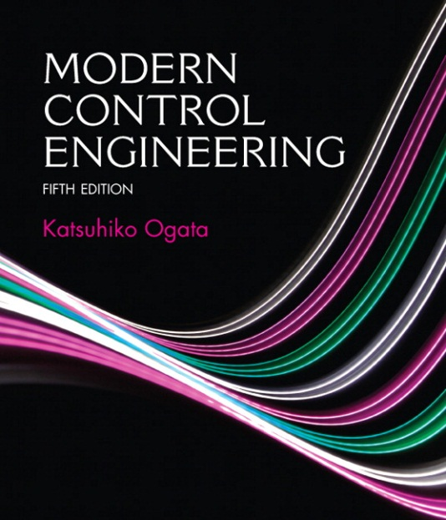
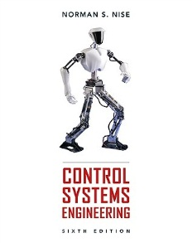
Text Books
Modern Control Engineering, (5th Edition)
By: Katsuhiko Ogata.
(Prof Emeritus)
Mechanical Engineering
University of Minnesota
Control Systems Engineering, (6th Edition)
By: Norman S. Nise. (Professor Emeritus)
Electrical and Computer Engineering Department
at California State Polytechnic University

Slide 5
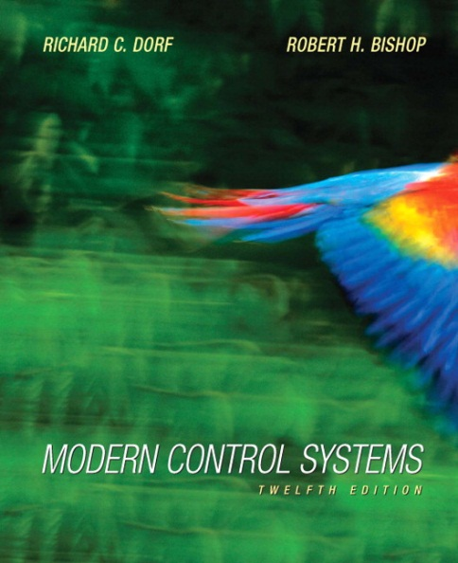
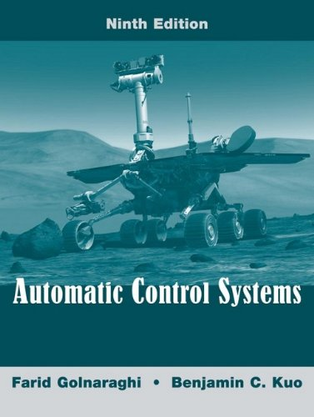
Reference Books
Modern Control Systems, (12th Edition)
By: Richard C. Dorf and Robert H. Bishop.
2. Automatic Control Systems, (9th Edition)
By: Golnaraghi and B. C. Kuo.

Slide 6
Prerequisites
For Classical Control Theory
Differential Equations
Laplace Transform
Basic Physics
Ordinary and Semi-logarithimic graph papers
For Modern Control theory above &
Linear Algebra
Matrices

Slide 7
What is Control System?
A system Controlling the operation of another system.
A system that can regulate itself and another system.
A control System is a device, or set of devices to manage, command, direct or regulate the behaviour of other device(s) or system(s).

Slide 8
Definitions
System – An interconnection of elements and devices for a desired purpose.
Control System – An interconnection of components forming a system configuration that will provide a desired response.
Process – The device, plant, or system under control. The input and output relationship represents the cause-and-effect relationship of the process.
Process
Input
Output

Slide 9
Definitions
Controlled Variable– It is the quantity or condition that is measured and Controlled. Normally controlled variable is the output of the control system.
Manipulated Variable– It is the quantity of the condition that is varied by the controller so as to affect the value of controlled variable.
Control – Control means measuring the value of controlled variable of the system and applying the manipulated variable to the system to correct or limit the deviation of the measured value from a desired value.

Slide 10
Definitions
Manipulated Variable
Input
or
Set point
or
reference
Controller
Process
Output
Or
Controlled Variable
Disturbances– A disturbance is a signal that tends to adversely affect the value of the system. It is an unwanted input of the system.
If a disturbance is generated within the system, it is called internal disturbance. While an external disturbance is generated outside the system.

Slide 11

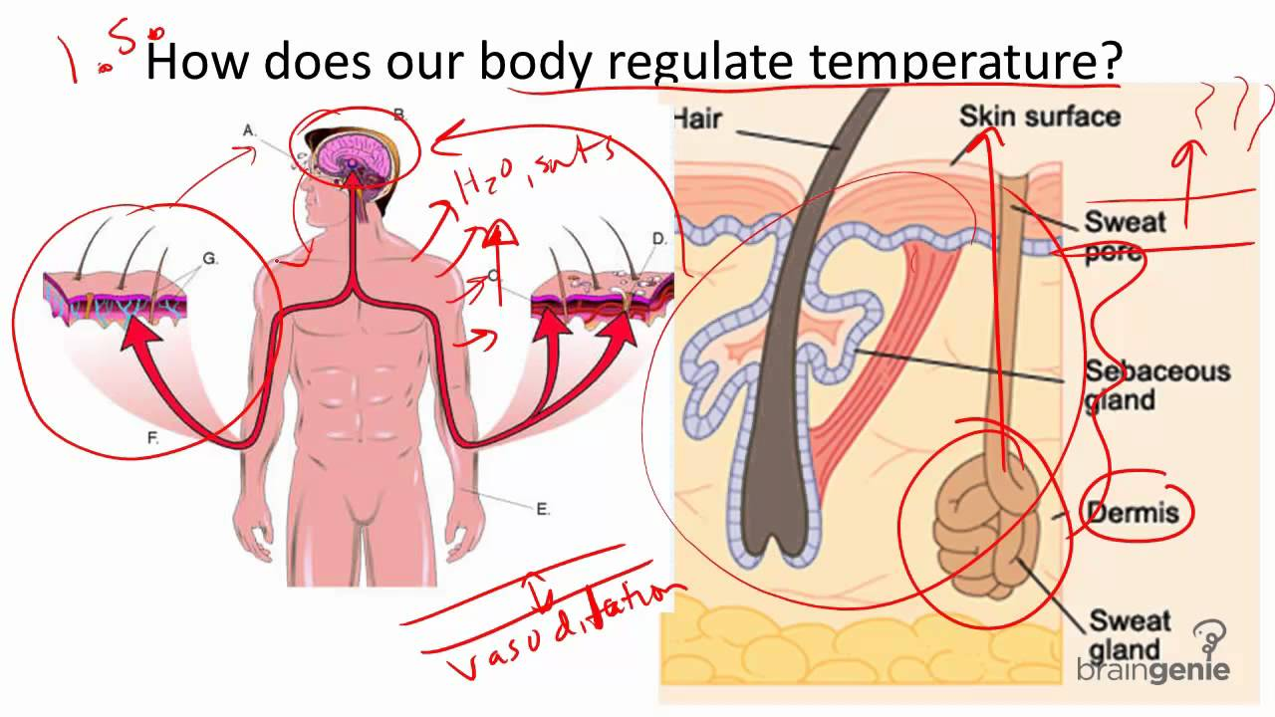
Types of Control System
Natural Control System
Universe
Human Body

Slide 12
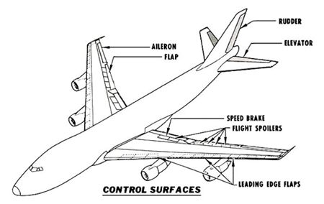
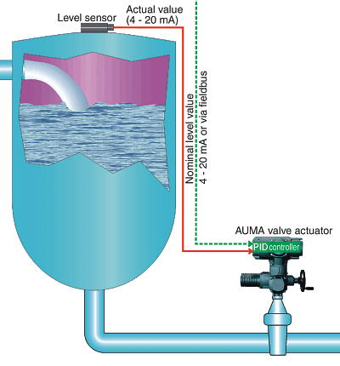
Types of Control System
Manmade Control System
Aeroplanes
Chemical Process

Slide 13
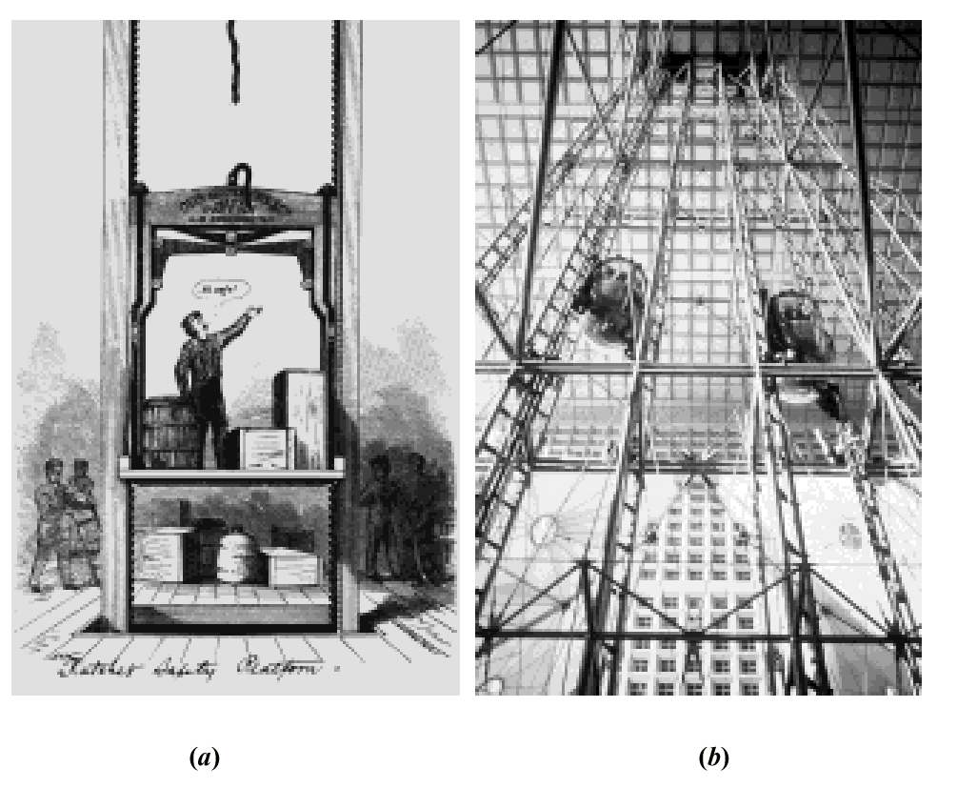
Elevators
Photos courtesy of United Technologies Otis Elevator.
a. Early elevators were controlled by hand ropes or an elevator operator. Here, a rope is cut to demonstrate the safety brake, an innovation in early
elevators;
b. Modern Duo-lift elevators make their way up the Grande Arche in Paris, driven by one motor, with each car counterbalancing the other. Today, elevators are fully automatic, using control systems to regulate position and velocity.

Slide 14
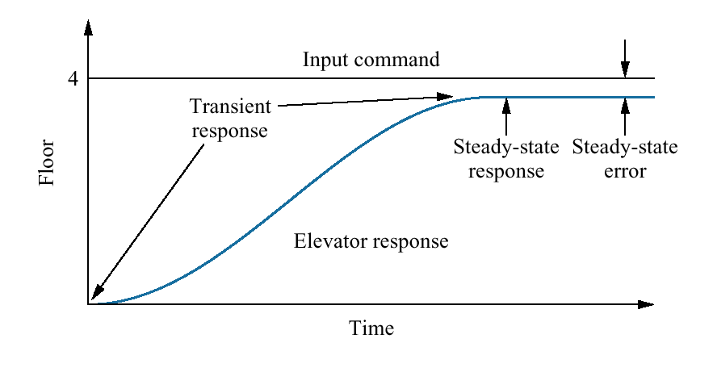
Elevator input and output

Slide 15
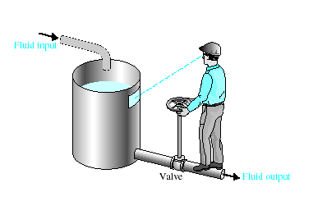
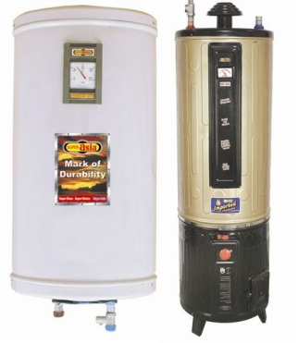
Types of Control System
Manual Control Systems
Room Temperature regulation Via Electric Fan
Water Level Control
Automatic Control System
Home Water Heating Systems (Geysers)
Room Temperature regulation Via A.C
Human Body Temperature Control

Slide 16

Types of Control System
Open-Loop Control Systems
Open-Loop Control Systems utilize a controller or control actuator to obtain the desired response.
Output has no effect on the control action.
In other words output is neither measured nor fed back.
Input
Controller
Process
Output
Examples:- Washing Machine, Toaster, Electric Fan, microwave oven, e.t.c

Slide 17
Types of Control System
Open-Loop Control Systems
Since in open loop control systems reference input is not compared with measured output, for each reference input there is fixed operating condition. Therefore, the accuracy of the system depends on calibration.
The performance of open loop system is severely affected by the presence of disturbances, or variation in operating/ environmental conditions.

Slide 18

Types of Control System
Closed-Loop Control Systems
Closed-Loop Control Systems utilizes feedback to compare the actual output to the desired output response.
Input
Controller
Process
Output
Comparator
Measurement
Examples:- Refrigerator, Electric Iron, Air conditioner

Slide 19
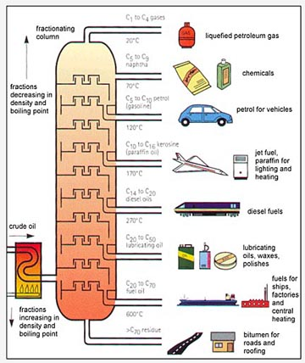
Types of Control System
Multivariable Control System
Outputs
Controller
Process
Temp
Humidity
Comparator
Pressure
Measurements

Slide 20
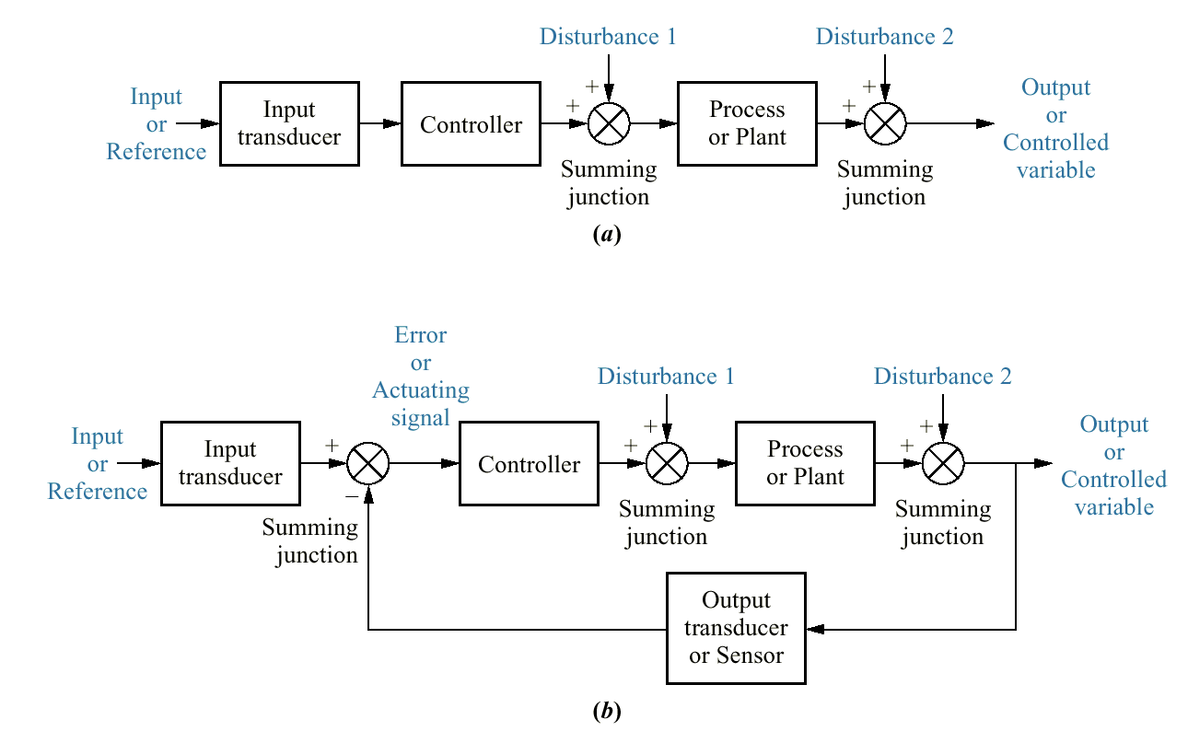
Figure 1.6 Block diagrams of control systems: a. open-loop system; b. closed-loop system

Slide 21
Types of Control System
Feedback Control System
A system that maintains a prescribed relationship between the output and some reference input by comparing them and using the difference (i.e. error) as a means of control is called a feedback control system.
Feedback can be positive or negative.
Controller
Process
Input
+
error
Output
-
Feedback

Slide 22
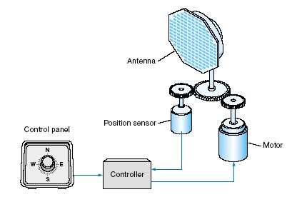
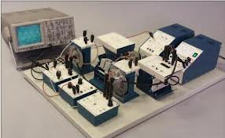
Types of Control System
Servo System
A Servo System (or servomechanism) is a feedback control system in which the output is some mechanical position, velocity or acceleration.
Antenna Positioning System
Modular Servo System (MS150)

Slide 23
Types of Control System
Linear Vs Nonlinear Control System
A Control System in which output varies linearly with the input is called a linear control system.
Process
u(t)
y(t)

Slide 24
Types of Control System
Linear Vs Nonlinear Control System
When the input and output has nonlinear relationship the system is said to be nonlinear.

Slide 25
Types of Control System
Time invariant vs Time variant
When the characteristics of the system do not depend upon time itself then the system is said to time invariant control system.
Time varying control system is a system in which one or more parameters vary with time.

Slide 26
Types of Control System
Continuous Data Vs Discrete Data System
In continuous data control system all system variables are function of a continuous time t.
A discrete time control system involves one or more variables that are known only at discrete time intervals.
x(t)
t
X[n]
n

Slide 27
Types of Control System
Deterministic vs Stochastic Control System
A control System is deterministic if the response to input is predictable and repeatable.
If not, the control system is a stochastic control system
x(t)
y(t)
t
t
z(t)
t

Slide 28
Classification of Control Systems
Control Systems
Natural
Man-made
Manual
Automatic
LTI Control Systems(Linear time invariant control systems)
Open-loop
Closed-loop
Non-linear
linear
Non-linear
linear
Time variant
Time invariant
Time variant
Time invariant

Slide 29
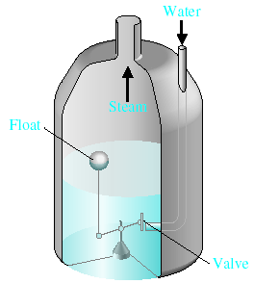
Examples of Control Systems
Water-level float regulator

Slide 30

Examples of Control Systems

Slide 31
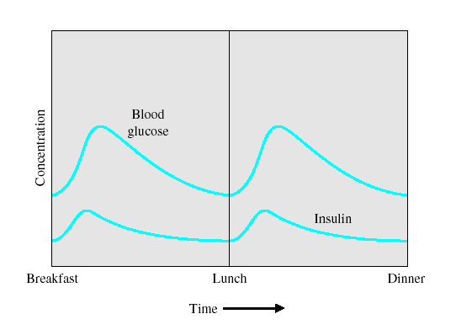

Examples of Modern Control Systems

Slide 32
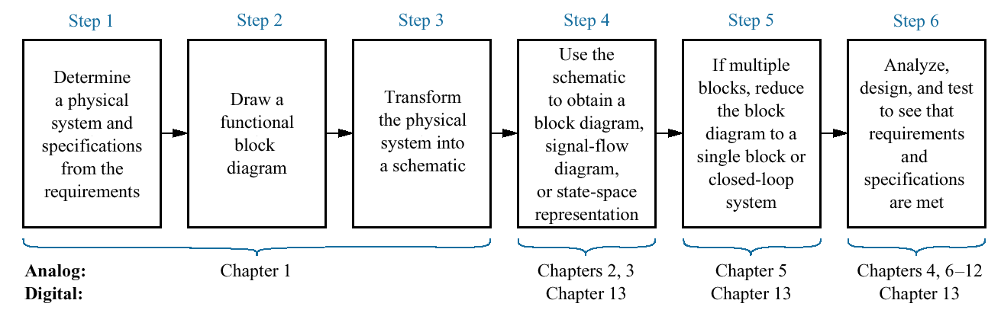
Figure 1.11 The control system design process

Slide 33
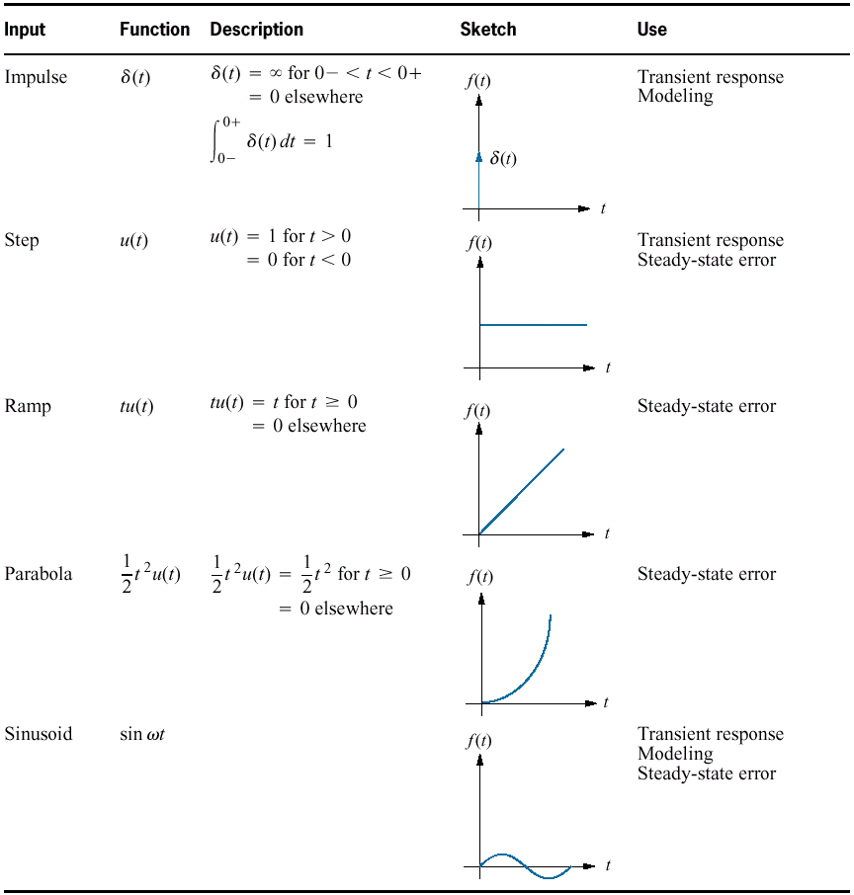
Table 1.1 Test waveforms used in control systems

Slide 34
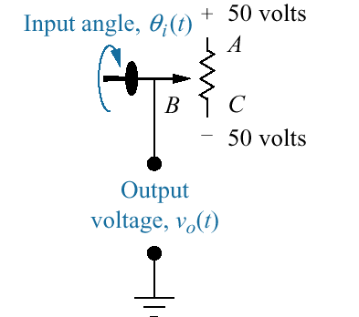
Figure P1.1 Potentiometer

Slide 35
Q&A

